Slide 1
POLS 207 State & Local Government*
Chapter 9B-1
Who Represents Who: Redistricting States
Dr. Roblyer, Ph.D.
*These slides are based on originals provided by Dr. Harvey Tucker

Slide 2
Learning Objectives
Describe how geographic representation works, as well as its drawbacks.
Explain how “equal” divisions of populations have been implemented since 1963.
Discuss the phrase “One person, one vote” and how it is interpreted to explain fairness in representation.
Compare and contrast “equal population” and “equal number of voters.”
List the political factors that politicians consider when drawing district lines.
Explain how a state’s apportionment can be both a legally fair and a politically unfair at the same time.
List and discuss the legal criteria for fair apportionment.

Slide 3
Learning Objectives
Describe how protected groups are connect to the Voting Rights Act and to apportionment in Texas today.
Discuss the role of maximum partisan advantage in redistricting and how this led to the Guardian headline: “In America, voters don’t pick their politicians, politicians pick their voters.”
Describe gerrymandering, including its origin and how it is done via packing and cracking.
Explain how researchers were able to accomplish a notional reversal of the 2012 congressional election results in Pennsylvania.
Describe what is often the consideration behind whether a district’s shape is acceptable or unacceptable.

Slide 4
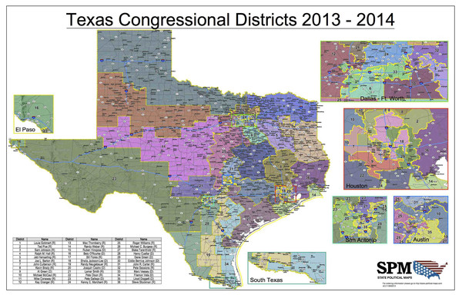
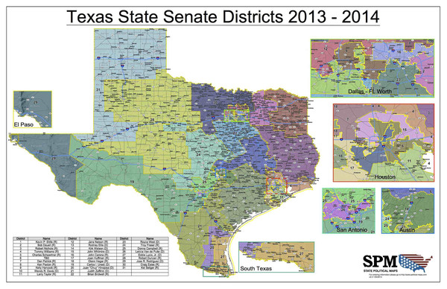
Representation Today: “Geographic”
36 for the House of Representatives
31 for State Senate
Despite similar #s, not much similarity
http://state-political-maps.com/products/2013-2014-texas-legislative-map-bundle
How else might representation be done?
a.k.a., “Zip-code representation”
How it is done everywhere in U.S.
Every level of representative government has its own boundaries—may overlap with another level’s
Challenges of geographic representation
Heterogeneous constituency without clear identity—”mix” of all types and concerns
Drives compromise as path to winning elections (unless boundaries are rigged—see “gerrymandering”)

Slide 5
Legislative and Congressional Redistricting
You will also hear “apportionment” and “districting” used instead
Increasingly, redistricting determines “who represents who”– not by elections!
Tremendous impact in current and future politics at state and national levels
“Fair” redistricting is defined as “equal” division of population within state
Permitted deviation: <1% (congressional) or <10% (state and local)
Equal population has been Courts’ standard since 1963
Goal: “One person, One vote”
Each legislator represents same number of people
Not same as “one voter, one vote” (each legislator would represent same number of voters)

Slide 6
Equal Population = Equal Voters
Typical District
High Alien Count
Prison / Military

Slide 7
How Can the Party in Power Apportion 100,000 State Residents?
Mostly, state legislatures apportion and draw district boundaries for state and national politics
Many ways to do this: party ID, likelihood of voting, registration rate, past record of voting

Slide 8
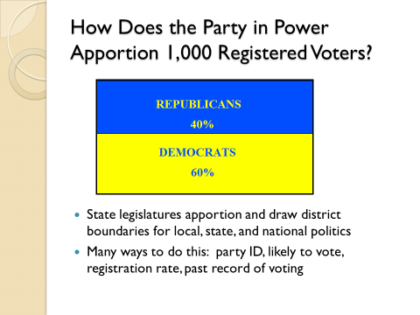
Different Districting Choices = Different Mixes of Representation
(Each proposed district contains 20,000 residents)
Option 1:
This is a legally fair plan because all districts contain same number of residents. You would also likely consider it politically fair because representatives are proportioned the same as the population by party

Slide 9
Different Districting Choices: Different Mixes of Representation
This is also a legally fair plan because all districts contain same number of residents. Yet, to many observers, this is a politically unfair result because representatives are NOT proportioned the same as the population by party
(Each proposed district contains 20,000 residents)
Option 2:

Slide 10
Redistricting: Four Formal Rules of the Game
Legally fair apportionment criteria (all must be met)
Equality of population – Within limits provided on previous chart
Contiguity – All portions of a district must be in contact with each other
Protected groups – Do groups previously prevented from voting by state law have a fair chance to affect the outcome of an election?
Shape of district – Cannot be “bizarre,” but can be “odd” (undefined terms used by courts)

Slide 11
More on Protected Groups
Protected groups are designated by Voting Rights Act
They are racial minorities that must receive special levels of attention to ensure fair treatment in elections
Concern extends from presence of representation to likelihood of winning election
Courts look at total population and number of adults, citizens, registered, and those who actually vote
Re-Districting Test: These groups cannot be “worse off” than in previous districting schemes
Other groups may lose at expense of protecting designated groups
Texas’ designated protected groups: African-Americans & Hispanics
IMPORTANT: So does the VRA and its “protected groups” still matter after Shelby v. Holder?

Slide 12

Gerrymandering: Partisan Redistricting
No prohibition against the party in power “stacking the deck” by choosing where to draw district boundaries for maximum partisan advantage
Both parties have done it, do it, and will do it again given the chance
Can do this and still follow all the rules of redistricting
TedED – Gerrymandering https://youtu.be/YcUDBgYodIE (turn on CC)
What is it? How did it begin?
Why is it done?
How is it done?
Packing & cracking
Vox on Gerrymandering https://youtu.be/KpamjJtXqFI (turn on CC)
Is this headline from a British newspaper accurate?
Optional, but
VERY good! >>
http://www.theguardian.com/commentisfree/2014/oct/09/virginia-gerrymandering-voting-rights-act-black-voters

Slide 13
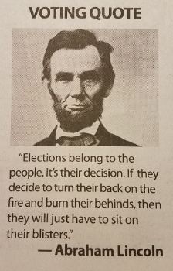
Gerrymandering: Partisan Redistricting
No prohibition against the party in power “stacking the deck” by choosing where to draw district boundaries for maximum partisan advantage
Both parties have done it, do it, and will do it again, given the chance
Can do this and still follow all the rules of redistricting
TedED – Gerrymandering https://mediamatrix.tamu.edu/streams/564035/TEDed_on_Gerrymandering
What is it? How did it begin?
Why is it done?
How is it done?
Packing & cracking
Is this headline from a British newspaper accurate?
http://www.theguardian.com/commentisfree/2014/oct/09/virginia-gerrymandering-voting-rights-act-black-voters

Slide 14
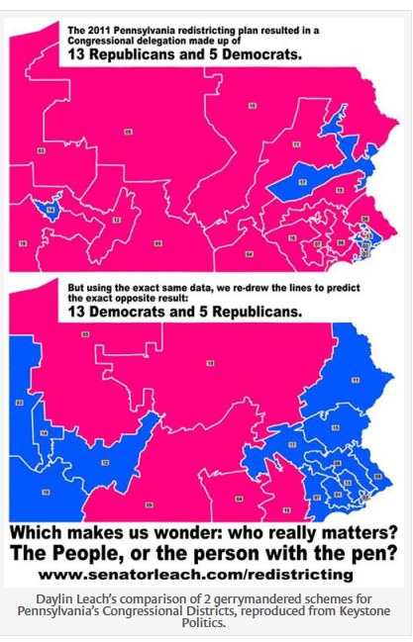
What is possible in theory:
This map of Pennsylvania is the actual 2011 redistricting plan
Resulted in election in 2012 of 13 Republican & 5 Democrat Congressional representatives
Notes:
Pittsburgh, Philadelphia, Allentown, Harrisburg

Slide 15
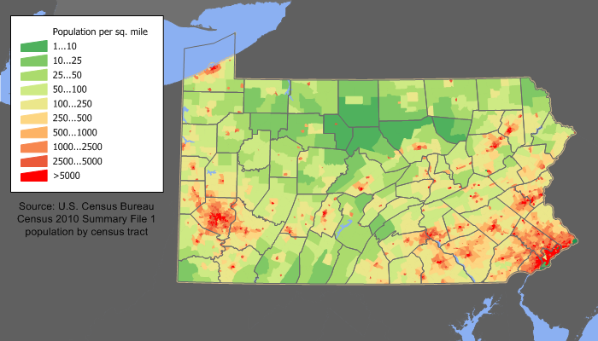
What is possible in theory:
This map of Pennsylvania is actual 2011 redistricting plan
Resulted in election in 2012 of 13 Republican & 5 Democrat Congressional representatives
This map shows how the Democratic districts correspond (mostly) to the areas of higher population density
What are the two major cities in the southern parts of the state?
Notes:
Pittsburgh, Philadelphia, Allentown, Harrisburg

Slide 16
What is possible in theory:
This map of Pennsylvania is actual 2011 redistricting plan
Resulted in election in 2012 of 13 Republican & 5 Democrat Congressional representatives
This new map hypothetically reverses election outcome by drawing district lines differently, while still following “equal population” and other rules
How WAS this done?
Notes:
Pittsburgh, Philadelphia, Allentown, Harrisburg

Slide 17
HUDDLE UP! Why are these legally acceptable and unacceptable shapes?
UNACCEPTABLE: TEXAS 30TH CONGRESSIONAL DISTRICT, 1990s
ACCEPTABLE: ILLINOIS 4TH CONGRESSIONAL DISTRICT, 1990s
“Not bizarre”
“Too bizarre”
http://commons.wikimedia.org/wiki/File:Texas_30th_CD_1991_-_1996.gif
http://www.senate.leg.state.mn.us/departments/scr/redist/redsum/ilsum.htm

Slide 18
HUDDLE UP! Why are these acceptable and unacceptable shapes?
UNACCEPTABLE: TEXAS 30TH CONGRESSIONAL DISTRICT, 1990s
ACCEPTABLE: ILLINOIS 4TH CONGRESSIONAL DISTRICT, 1990s
Done to protect ability of Hispanic vote to influence elections
Done to reduce influence of Black vote in elections
“Not bizarre”
“Too bizarre”
http://commons.wikimedia.org/wiki/File:Texas_30th_CD_1991_-_1996.gif
http://www.senate.leg.state.mn.us/departments/scr/redist/redsum/ilsum.htm

Slide 19
Practice Problems …to begin mastering this material. Complete instructions are in the Module 1 resource, How to Use Practice Problems to Prepare for Exams.
Don’t forget to do the…

